Slide 1
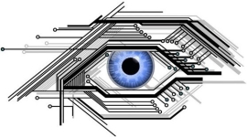
SMART EYE

Slide 2
Outline
Introduction
Vision & Mission
Existing System
Work Model
Benefits
Limitation
Conclusion

Slide 3
Sr No. | Name
01 | Shaikh Shahid Sameer
02 | Dudhade Jayesh Bhausaheb
03 | Gaikwad Abhijeet Popat
04 | Karan Sathe
05 | Tanpure Gaurav Shivaji

Slide 4
Introduction
This system aims to build an application that detect the vehicle’s number plate, classify the vehicle, check the total count and speed of vehicle which uses the concept of automatically storing and maintaining vehicle records instead of doing it manually which is very time consuming.
Vehicle detection and counting is very important in traffic monitoring, military applications, toll collection etc.

Slide 5
Vision & Mission
Our vision is to create highly accurate reliable vehicle detection system , that enhances safety and efficiency on the roads , while also reducing environmental impact.
To develop and implement and intelligent that can accurately and detect and track vehicle on real time
It include sensor camera and other devices
The mission also include continuously improving this systems performance accuracy reliable throw research and development of new technology and algorithm

Slide 6
Existing System
There are several existing systems available in market for Vehicle detection and counting.
Mostly these systems are used at Toll Plaza to detect vehicle and maintain vehicle record.
To gain basic knowledge about existing system we conducted survey at Supa Toll Plaza.
By conducting this survey we got some basic knowledge about existing systems in the market which was very helpful for us.

Slide 7
Work Model
Recording / Live
Count
Speed
Category
Number Plate

Slide 8
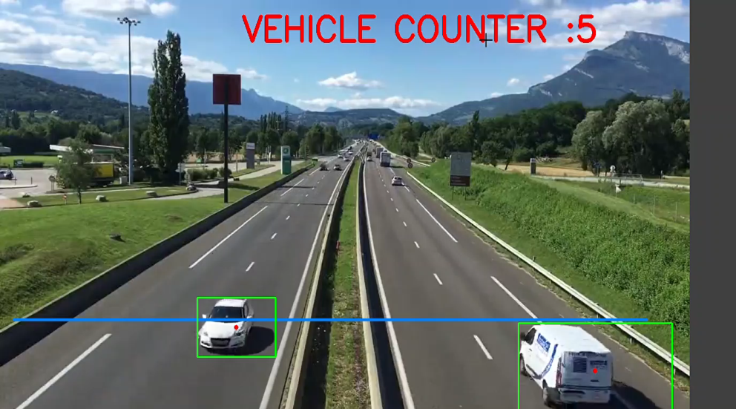
Perform on live stream and video clip.
Modules are show using button.
Data while be store in database.

Slide 9
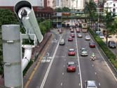
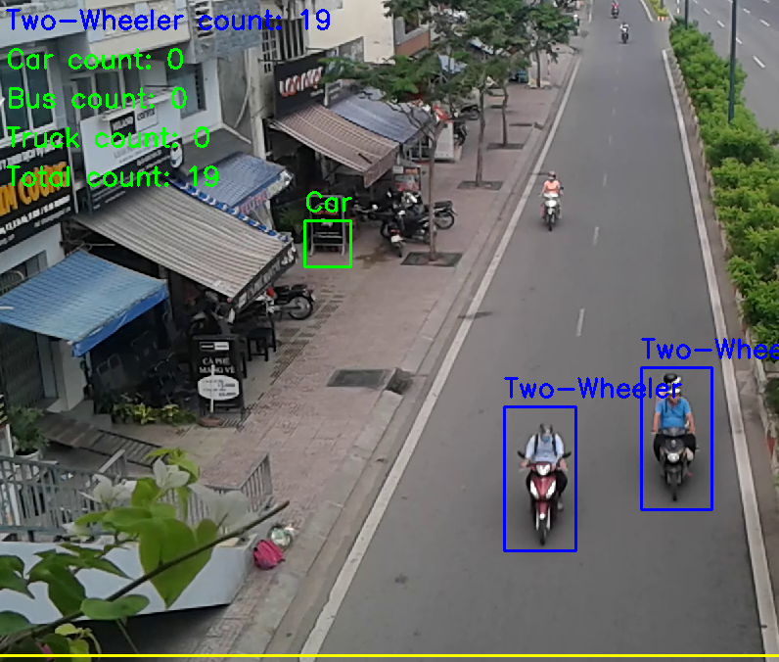
Fixed view camera
Manual set-up

Slide 10
Benefits
Detection of Multiple Moving Vehicle in a recording and live streme.
Track and keep count of the detected vehicles.
Identification of vehicle types.
All capture data will be store in database.

Slide 11
Limitation
Unable to detect in poor visual video streams
Limited data storage.
After some time data will be erase.

Slide 12
Conclusion

